Slide 1
Chapter 7: Computer and Network Security

Slide 2
Chapter Overview
Introduction
Hacking
Malware
Cyber crime and cyber attacks
Online voting

Slide 3
7.1 Introduction
Computers getting faster and less expensive
Utility of networked computers increasing
Shopping and banking
Managing personal information
Controlling industrial processes
Increasing use of computers → growing importance of computer security

Slide 4
7.2 Hacking

Slide 5
Hackers, Past and Present
Original meaning of hacker: explorer, risk taker, system innovator
MIT’s Tech Model Railroad Club in 1950s
1960s-1980s: Focus shifted from electronics to computers and networks
1983 movie WarGames
Modern meaning of hacker: someone who gains unauthorized access to computers and computer networks

Slide 6
Obtaining Login Names and Passwords
Eavesdropping
looking over the shoulder of a legitimate user to learn his login name and password
Dumpster diving
looking through garbage for interesting information
Social engineering
manipulation of a person inside the organization to gain access to confidential information

Slide 7
Computer Fraud and Abuse Act
Criminalizes wide variety of hacker-related activities
Transmitting code that damages a computer
Accessing any Internet-connected computer without authorization
Transmitting classified government information
Trafficking in computer passwords
Computer fraud
Computer extortion
Maximum penalty: 20 years in prison and $250,000 fine

Slide 8
Sidejacking
Sidejacking: hijacking of an open Web session by capturing a user’s cookie
Sidejacking possible on unencrypted wireless networks because many sites send cookies “in the clear”
Internet security community complained about sidejacking vulnerability for years, but ecommerce sites did not change practices

Slide 9
Case Study: Firesheep
October 2010: Eric Butler released Firesheep extension to Firefox browser
Firesheep made it possible for ordinary computer users to easily sidejack Web sessions
More than 500,000 downloads in first week
Attracted great deal of media attention
Early 2011: Facebook and Twitter announced options to use their sites securely

Slide 10
Utilitarian Analysis
Release of Firesheep led media to focus on security problem
Benefits were high: a few months later Facebook and Twitter made their sites more secure
Harms were minimal: no evidence that release of Firesheep caused big increase in identity theft or malicious pranks
Conclusion: Release of Firesheep was good

Slide 11
Kantian Analysis
Accessing someone else’s user account is an invasion of their privacy and is wrong
Butler provided a tool that made it much simpler for people to do something that is wrong, so he has some moral accountability for their misdeeds
Butler was willing to tolerate short-term increase in privacy violations in hope that media pressure would force Web retailers to add security
He treated victims of Firesheep as a means to his end
It was wrong for Butler to release Firesheep

Slide 12
7.3 Malware

Slide 13
Viruses
Virus: Piece of self-replicating code embedded within another program (host)
Viruses associated with program files
Hard disks, floppy disks, CD-ROMS
Email attachments
How viruses spread
Diskettes or CDs
Email
Files downloaded from Internet

Slide 14
How a Virus Replicates
Program P, which is infected with a virus, is executed
The virus code executes. It finds another program Q and creates a new version of Q infected with the virus
The virus passes control to program P. The user is unaware of the presence of the virus

Slide 15
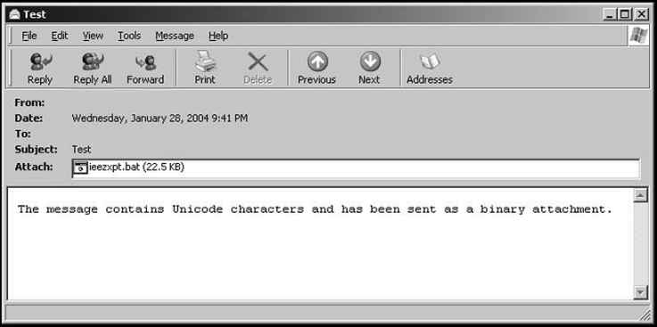
How an Email Virus Spreads
Email Attachment with Possible Virus

Slide 16
Antivirus Software Packages
Allow computer users to detect and destroy viruses
Must be kept up-to-date to be most effective
Many people do not keep their antivirus software packages up-to-date
Consumers need to beware of fake antivirus applications

Slide 17
Worm
Self-contained program
Spreads through a computer network
Exploits security holes in networked computers

Slide 18
How a Worm Spreads

Slide 19
The Internet Worm
Robert Tappan Morris, Jr.
Graduate student at Cornell (1988)
Released worm onto Internet from MIT computer
Effect of worm
Spread to significant numbers of Unix computers
Infected computers kept crashing or became unresponsive
Took a day for fixes to be published
Impact on Morris
Suspended from Cornell
3 years’ probation + 400 hours community service
$150,000 in legal fees and fines

Slide 20
Ethical Evaluation
Kantian evaluation
Morris used others by gaining access to their computers without permission
Social contract theory evaluation
Morris violated property rights of organizations
Utilitarian evaluation
Benefits: Organizations learned of security flaws
Harms: Time spent by those fighting worm, unavailable computers, disrupted network traffic, Morris’s punishments
Morris was wrong to have released the Internet worm

Slide 21
Cross-site Scripting
Another way malware may be downloaded without user’s knowledge
Problem appears on Web sites that allow people to read what others have posted
Attacker injects client-side script into a Web site
Victim’s browser executes script, which may steal cookies, track user’s activity, or perform another malicious action

Slide 22
Drive-by Downloads
Unintentional downloading of malware caused by visiting a compromised Web site
Also happens when Web surfer sees pop-up window asking permission to download software and clicks “Okay”
Google Anti-Malware Team says 1.3 percent of queries to Google’s search engine return a malicious URL somewhere on results page

Slide 23
Trojan Horses and Backdoor Trojans
Trojan horse: Program with benign capability that masks a sinister purpose
Backdoor Trojan: Trojan horse that gives attack access to victim’s computer

Slide 24
Rootkits
Rootkit: A set of programs that provides privileged access to a computer
Activated every time computer is booted
Uses security privileges to mask its presence

Slide 25
Spyware and Adware
Spyware: Program that communicates over an Internet connection without user’s knowledge or consent
Monitor Web surfing
Log keystrokes
Take snapshots of computer screen
Send reports back to host computer
Adware: Type of spyware that displays pop-up advertisements related to user’s activity
Backdoor Trojans often used to deliver spyware and adware

Slide 26
Bots
Bot: A kind of backdoor Trojan that responds to commands sent by a command-and-control program on another computer
First bots supported legitimate activities
Internet Relay Chat
Multiplayer Internet games
Other bots support illegal activities
Distributing spam
Collecting person information for ID theft
Denial-of-service attacks

Slide 27
Botnets and Bot Herders
Botnet: Collection of bot-infected computers controlled by the same command-and-control program
Some botnets have over a million computers in them
Bot herder: Someone who controls a botnet

Slide 28
Defensive Measures
Security patches: Code updates to remove security vulnerabilities
Anti-malware tools: Software to scan hard drives, detect files that contain viruses or spyware, and delete these files
Firewall: A software application installed on a single computer that can selectively block network traffic to and from that computer

Slide 29
7.4 Cyber Crime and Cyber Attacks

Slide 30
Phishing and Spear-phishing
Phishing: Large-scale effort to gain sensitive information from gullible computer users
At least 67,000 phishing attacks globally in second half of 2010
New development: increase in phishing attacks on Chinese e-commerce sites
Spear-phishing: Variant of phishing in which email addresses chosen selectively to target particular group of recipients

Slide 31
SQL Injection
Method of attacking a database-driven Web application with improper security
Attack inserts (injects) SQL query into text string from client to application
Application returns sensitive information

Slide 32
Denial-of-service and Distributed Denial-of-service Attacks
Denial-of-service attack: Intentional action designed to prevent legitimate users from making use of a computer service
Aim of a DoS attack is not to steal information but to disrupt a server’s ability to respond to its clients
Distributed denial-of-service attack: DoS attack launched from many computers, such as a botnet

Slide 33
Cyber Crime (PP. 332-334)
Criminal organizations making significant amounts of money from malware
Jeanson James Ancheta
Pharmamaster
Albert Gonzalez
Avalanche Gang

Slide 34
The Rise and Fall of Blue Security Part I: The Rise
Blue Security: An Israeli company selling a spam deterrence system
Blue Frog bot would automatically respond to each spam message with an opt-out message
Spammers started receiving hundreds of thousands of opt-out messages, disrupting their operations
6 of 10 of world’s top spammers agreed to stop sending spam to users of Blue Frog

Slide 35
The Rise and Fall of Blue Security Part II: The Fall
One spammer (PharmaMaster) started sending Blue Frog users 10-20 times more spam
PharmaMaster then launched DDoS attacks on Blue Security and its business customers
Blue Security could not protect its customers from DDoS attacks and virus-laced emails
Blue Security reluctantly terminated its anti-spam activities

Slide 36
Politically Motivated Cyber Attacks (PP. 334-337)
Estonia (2007)
Georgia (2008)
Georgia (2009)
Exiled Tibetan Government (2009)
United States and South Korea (2009)
Stuxnet Worm (2009)

Slide 37
Attacks on Twitter and Other Social Networking Sites
Massive DDoS attack made Twitter service unavailable for several hours on August 6, 2009
Three other sites attacked at same time: Facebook, LiveJournal, and Google
All sites used by a political blogger from the Republic of Georgia
Attacks occurred on first anniversary of war between Georgia and Russia over South Ossetia

Slide 38
Fourth of July Attacks
4th of July weekend in 2009: DDoS attack on governmental agencies and commercial Web sites in United States and South Korea
Attack may have been launched by North Korea in retaliation for United Nations sanctions

Slide 39
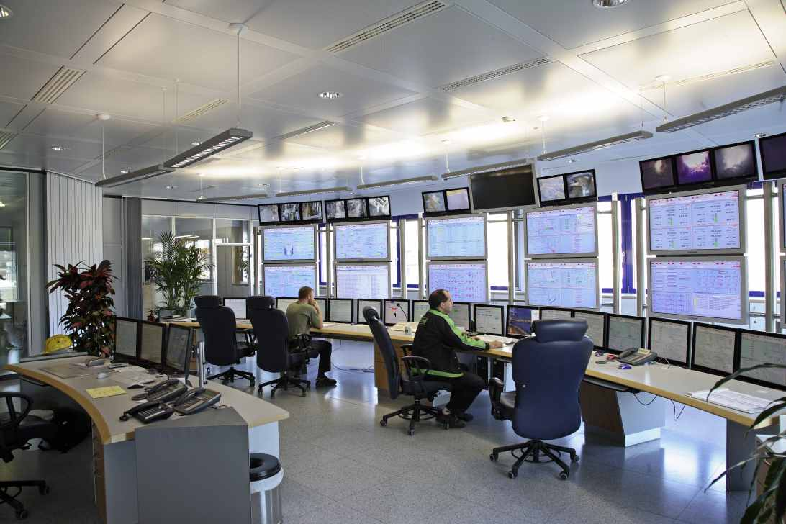
Supervisory Control and Data Acquisition (SCADA) Systems
Industrial processes require constant monitoring
Computers allow automation and centralization of monitoring
Today, SCADA systems are open systems based on Internet Protocol
Less expensive than proprietary systems
Easier to maintain than proprietary systems
Allow remote diagnostics
Allowing remote diagnostics creates security risk

Slide 40
Stuxnet Worm (2009)
Attacked SCADA systems running Siemens software
Targeted five industrial facilities in Iran that were using centrifuges to enrich uranium
Caused temporary shutdown of Iran’s nuclear program
Worm may have been created by Israeli Defense Forces

Slide 41
7.5 Online Voting

Slide 42
Motivation for Online Voting
2000 U.S. Presidential election closely contested
Florida pivotal state
Most Florida counties used keypunch voting machines
Two voting irregularities traced to these machines
Hanging chad
“Butterfly ballot” in Palm Beach County

Slide 43
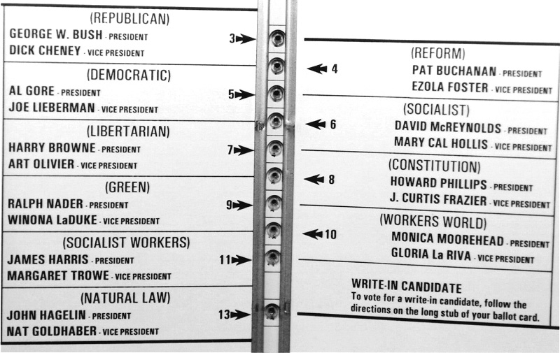
The Infamous “Butterfly Ballot”
AP Photo/Gary I. Rothstein

Slide 44
Benefits of Online Voting
More people would vote
Votes would be counted more quickly
No ambiguity with electronic votes
Cost less money
Eliminate ballot box tampering
Software can prevent accidental over-voting
Software can prevent under-voting

Slide 45
Risks of Online Voting
Gives unfair advantage to those with home computers
More difficult to preserve voter privacy
More opportunities for vote selling
Obvious target for a DDoS attack
Security of election depends on security of home computers
Susceptible to vote-changing virus
Susceptible to phony vote servers
No paper copies of ballots for auditing or recounts

Slide 46
Utilitarian Analysis
Suppose online voting replaced traditional voting
Benefit: Time savings
Assume 50% of adults actually vote
Suppose voter saves 1 hour by voting online
Average pay in U.S. is $18.00 / hour
Time savings worth $9 per adult American
Harm of DDoS attack difficult to determine
What is probability of a DDoS attack?
What is the probability an attack would succeed?
What is the probability a successful attack would change the outcome of the election?

Slide 47
Kantian Analysis
The will of each voter should be reflected in that voter’s ballot
The integrity of each ballot is paramount
Ability to do a recount necessary to guarantee integrity of each ballot
There should be a paper record of every vote
Eliminating paper records to save time and/or money is wrong

Slide 48
Conclusions
Existing systems are highly localized
Widespread tainting more possible with online system
No paper records with online system
Evidence of tampering with online elections
Relying on security of home computers means system vulnerable to fraud
Strong case for not allowing online voting

